Slide 1
The Basic Assembly Language Programming Concepts

Slide 2
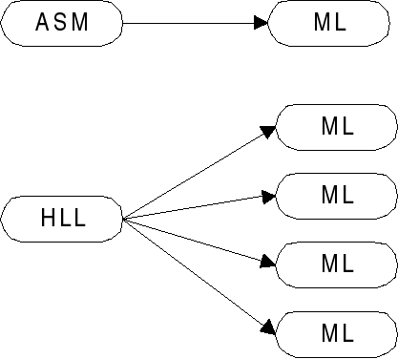
What is Assembly Language?
A low-level processor-specific programming language design to match the processor’s machine instruction set
Each assembly language instruction matches exactly one machine language instruction

Slide 3
Why learn Assembly Language?
To learn how high-level language code gets translated into machine language
  i.e.: to learn the details hidden in HLL code
To learn the computer’s hardware
  by direct access to
    memory
    video controller
    sound card
    keyboard…
To speed up applications
  direct access to hardware (ex: writing directly to I/O ports instead of doing a system call)
  good ASM code is faster and smaller: rewrite in ASM the critical areas of code

Slide 4
Assembly Language Applications
Application programs are rarely written completely in assembly language
  only time-critical parts are written in ASM
    An interface subroutine (called from HLL programs) is written in ASM for direct hardware access
    Device drivers (called from the OS)
ASM often used for embedded systems (programs stored in PROM chips)
    computer cartridge
    Games
    Microcontrollers (automobiles, industrial plants...)
    telecommunication equipment…
Very fast and compact but processor-specific

Slide 5
Advantages of Assembly Language
Shows how program interfaces with the processor, operating system, and BIOS.
Shows how data is represented and stored in memory and on external devices.
Clarifies how processor accesses and executes instructions and how instructions access and process data.
Clarifies how a program accesses external devices.

Slide 6
The Assembly Language Programming Process
Assembly language programming requires the use of application program knows as utilities or tools
An assembly language is specific to a unique microprocessor CPU
An assembly language programmer must know the internal make up of CPU in order to program it.
CPUs are not interchangeable
ASM program written for an intel 8086 will not work for intel 8051
ASM programs are not transportable

Slide 7
The following programs are essential to your success
An operating system program
A word processing often called Text editor
An assembler program
A testing program- Debuggers or Simulators

Slide 8
Assembly Vs High level language
To speed computer operations
To reduce the size of the program
To write the program for special situations
To save money
To better understanding how the computer operates

Slide 9
Programming Tools and Techniques
Learn about CPU architecture
Learn a set of CPU assembly language instructions
Learn how to use personal computer and its host OS.
Learn how to use Text editor
Learn how to use an assembler
Learn how to use debugger
Practice writing and running small programs
Add new assembly language instructions and master their use.
Continue to write larger and more complicated program

Slide 10
The PAL Practice CPU
Practice assembly language program or PAL
8051 assembly language is a subset of English language
Register A - Performs all operations in the CPU
Register R- Stores numbers temporarily
Program Counter – Holds the address of next Register
PAL 64k ROM memory
Program Data
PAL RAM Data memory

Slide 11
Understanding Assembly language Syntax
8051 assembly language is a subset of the English language
The rules of spellings, grammar , punctuations are more rigidly defined.
The rules that apply to particular assembly code language
Assemblers are very picky about syntax

Slide 12
  Mov r0,r1 (intel 8051)
  ld a,b (ziglog z80)
  Move w a1,d1 (motorola 68000)
  Mov ds,ax (intel 8086)
  Txa (rockwell 6502)
  For example the z80 “loads (ld ) data
  the 68000 “moves “ (move) data
  the 8086 uses moves data also (MOV)

Slide 13
Understanding Assembler Program
Assembly language programming in the bad old days
Done entirely manual fashion
When a new lines of code is inserted into a program and all addresses of each line code is reassigned .

Slide 14
Write the program ,on a pad of paper ,using the instruction mnemonics
Convert each instruction to its hexadecimal code ,using a code book that lists each instruction mnemonic and it hexadecimal code
Assign each code byte an address in code memory
Use a paper tape punch to record the program code bytes
Enter the program into computer code memory via a paper tape reader under control of a reader utility program .
Find the mistake ,re-write the re-code the program ,and re-enter it .

Slide 15
Assembler Directives
An assembler program is program like other, that has it own programming language instructions that must be understood before any programs can be written.
The title given to an assembler program language instruction is a directive

Slide 16
Write a program in instruction mnemonics , using a computer and text editor.
Store the edited assembly language program into a disk file
Use a program ,called an assembler , to convert the assembly language file stored on the disk to a second disk file
The second disk file contains the binary equivalents of the assembly language file that the computer can execute (machine language instruction )
Load the assembled machine –language program from disk into computer RAM and test the program using debugger program
Find the mistakes , re-edit the program , re-assemble , load and test again .

Slide 17
The 8051 Archicture

Slide 18
Introduction
General-purpose microprocessor
CPU for Computers
No RAM, ROM, I/O on CPU chip itself
Example：Intel’s x86, Motorola’s 680x0
Many chips on mother’s board
Data Bus
CPU
General-Purpose Micro-processor
Serial COM Port
RAM
ROM
I/O Port
Timer
Address Bus
General-Purpose Microprocessor System
Notes:
Intel’s x86: 8086,8088,80386,80486, Pentium
Motorola’s 680x0: 68000, 68010, 68020,68030,6040

Slide 19
Microcontroller :
A smaller computer
On-chip RAM, ROM, I/O ports...
Example：Motorola’s 6811, Intel’s 8051, Zilog’s Z8 and PIC 16X
CPU
RAM
ROM
A single chip
Serial COM Port
I/O Port
Timer
Microcontroller

Slide 20
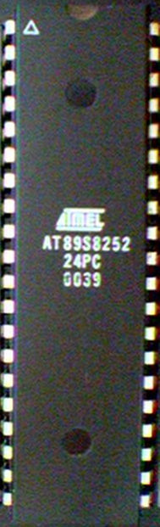
8051 Basic Component
4K bytes internal ROM
128 bytes internal RAM
Four 8-bit I/O ports (P0 - P3).
Two 16-bit timers/counters
One serial interface
CPU
RAM
ROM
A single chip
I/O Port
Serial COM Port
Microcontroller
Timer

Slide 21
Block Diagram Microcontroller (old chip)
External Interrupts
Interrupt
Control
4k
ROM
128 bytes
RAM
Timer 1
Timer 2
CPU
OSC
Bus
Control
4 I/O Ports
Serial
P0 P2 P1 P3
TXD
RXD
Addr/Data

Slide 22
Three criteria in Choosing a Microcontroller
meeting the computing needs of the task efficiently and cost effectively
  speed, the amount of ROM and RAM, the number of I/O ports and timers, size, packaging, power consumption
  easy to upgrade
  cost per unit
availability of software development tools
  assemblers, debuggers, C compilers, emulator, simulator, technical support
wide availability and reliable sources of the microcontrollers

Slide 23
8051 Family (8051, 8052, 802051, etc)
The 8051 is a Single Chip Computer or microcontroller Developed Initially by Intel. It is one of the most widely used microcontroller chips in the world.
Other Companies have binary-compatible microcontrollers with additional features
There are several versions of the 8051 family. At the lowest end there is a 20-pin AT89C2051

Slide 24
8051 Microcontroller Hardware

Slide 25
8051 Microcontroller Hardware
8051 microcontroller is the generic part number includes a whole family of microcontroller
From 8031 to 8751 are available in N-channel Metal Oxide Silicon (NMOS) and Complementary Metal Oxide Silicon (CMOS)
The enhanced version of 8051 is 8052
8051microcontroller has 40 pins

Slide 26
Features of microcontroller
Internal RAM and ROM
I/O ports with programmable pins
Timers and counters
Serial data communication
Program counter
ALU
Working register
Clock circuits

Slide 27
8051 architecture features
Eight –bit CPU with register A and B
Sixteen –bit program counter (PC) and data pointer (DPTR)
Eight –bit program status word (PSW)
Eight –bit stack pointer (SP)
Internal ROM or EPROM
Internal RAM of 128 bytes
  Four register banks ,each containing eight register
  Sixteen bytes ,which may be addressed at the bit level
  Eight bytes of general –purpose data memory

Slide 28
8051 architecture features
Thirty-two input /output pins arranged as four 8-bit ports P₀ – P₃
Two 16-bit timers/counters T_{O} and T_{I}
Full duplex serial data receiver /transmitter SBUF
Control register TCON,TMOD,SCON, PCON IP and IE
Two external and three internal sources
Oscillator and clock circuits

Slide 29
Basic 8051 Characteristics
4K bytes of internal ROM
128 bytes of internal RAM:
  four register banks (0 - 3), each containing R0 - R7 8-bit registers.
  16 bytes of bit addressable area.
  80 bytes of general purpose memory.
Four 8-bit I/O ports (P0 - P3).
Two 16-bit timers/counters
One serial receiver/ transmitter (UART) interface.
One instruction cycle = 12 clock cycles (1us per instruction at 12 MHz clock)
Five (2 external and 3 internal) interrupt sources.
Expandable to 64K external code (program) memory space.
Expandable to 64K external data memory space.
Boolean instructions work with one bit at a time.
4 μs for either an 8-bit multiply or divide instruction. (Assume a 12 MHz clock signal).
On chip oscillator to generate clock.
One cycle 8-bit Multiply and Divide Instructions – Very Limited use

Slide 30
8051 Registers
ACC - accumulator
B - used in multiply and divide
PSW - Program Status Word
SP - Stack Pointer
PC Program Counter - not user accessible
IP, IE (Interrupt Priority and Interrupt Enable)
DPH and DPL (Data Pointer High and Low)
PCON – Power Control Register
SBUFFER and SCON – Serial Buffer and Serial Control Reg
TH0, TL0, TH1, TL1 – (Timer High and Low 0 and 1)
TCON and TMOD – Timer Control Reg and Timer Mode Reg
PSW:
CY - Carry
AC – Aux. Carry (cy from b2 to b3 - BCD)
F0 – General Use Flag – no specific func
RS0,RS1 - Bank Select (4 banks or sets)
OV - Overflow
- User defined flag
P - Parity
CY AC F0 RS1 RS0 OV - P
0 0 - 00h to 07h 0 1 - 08h to 0Fh 1 0 - 10h to 17h 1 1 - 18h to 1Fh

Slide 31
A Accumulator
B Arithmetic
DPH Addressing External Memory
DPL Addressing External Memory
IE Interrupt Enable control
IP Interrupt Priority
P0 I/O port latch
P1 I/O port latch
P2 I/O port latch
P3 I/O port latch
PCON Power control
PSW Program Status Word
SCON Serial Port Control
SBUF Serial Port Data Buffer
SP Stack Pointer
TMOD Timer /counter mode control
TCON Timer/counter ontrol
TL0 Timer 0 low byte
TH0 Timer 0 high byte
TL1 Timer 1 low byte
TH1 Timer 1 high byte

Slide 32
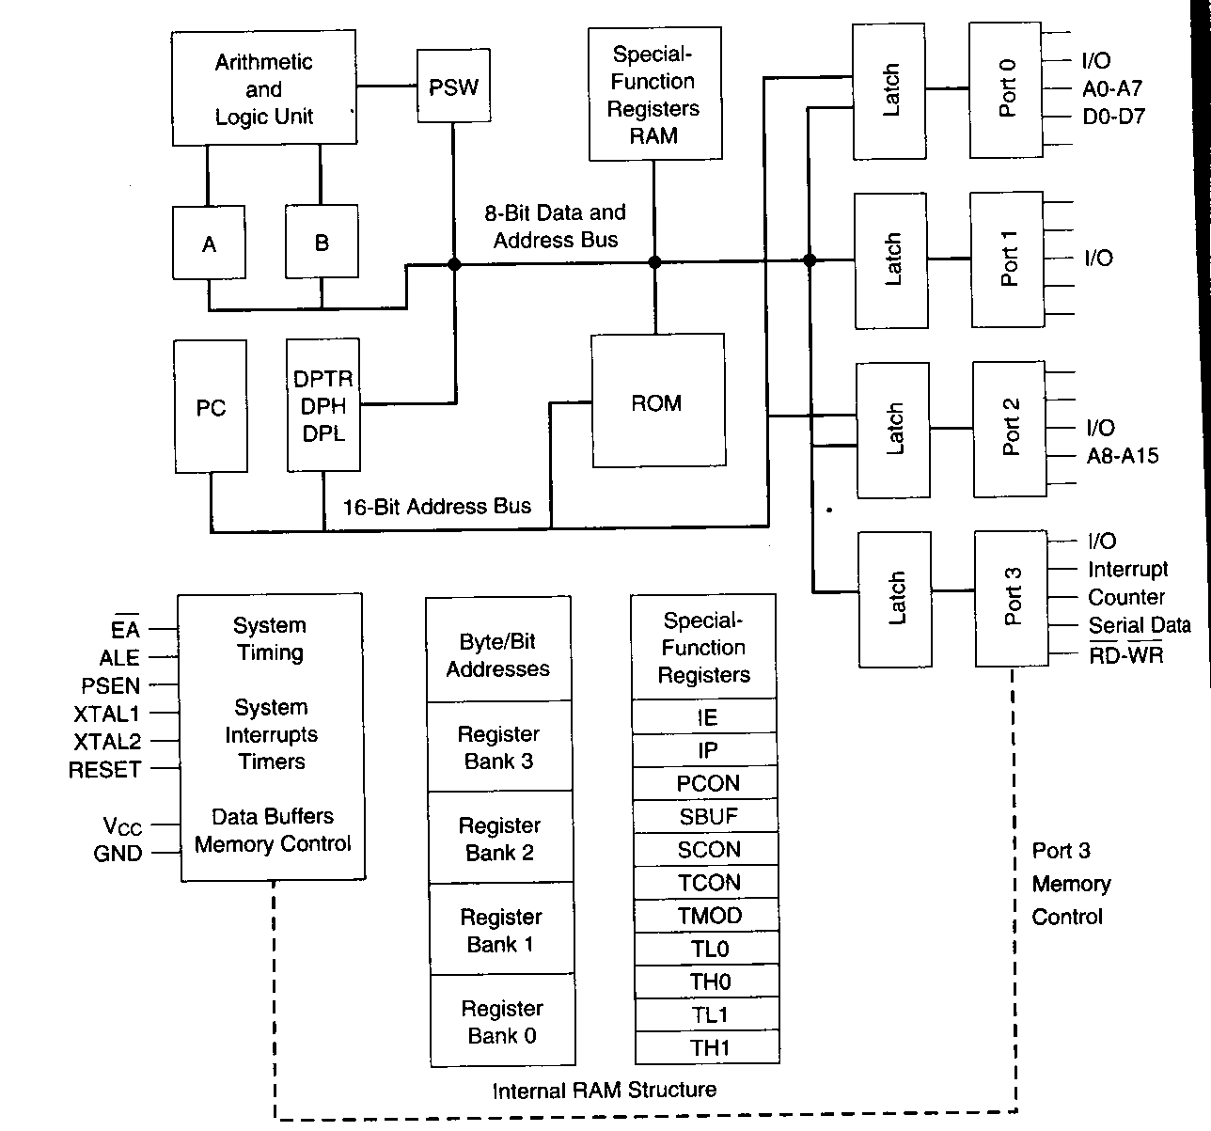
Block diagram of 8051

Slide 33
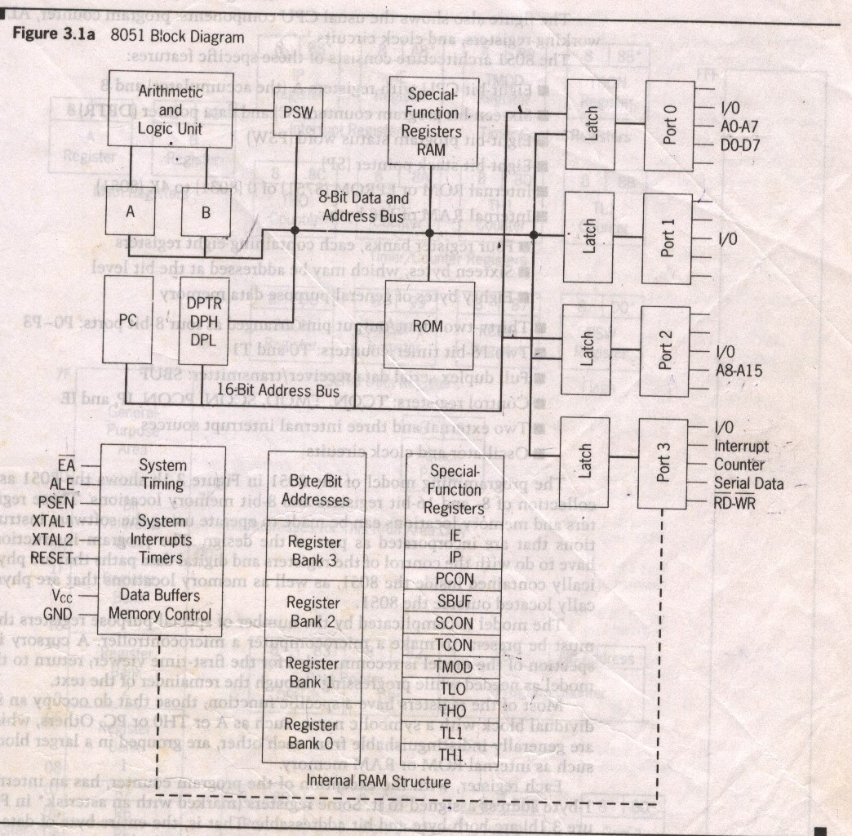
Block Diagram

Slide 34
8051 Programming Model
The programming model of 8051 shows a collection of 8 and 16 –bit memory locations
These registers and memory locations can be made to operate using software instruction
The model is complicated by number of special purpose register
The model shows the register are both bit and byte addressable
Most of the register have special functions which occupy the symbolic name as A, THO or PC
Each register has an internal 1byte address assigned to it ,some register marked with “*” are both bit and byte addressable

Slide 35
8051 programmable model

Slide 36
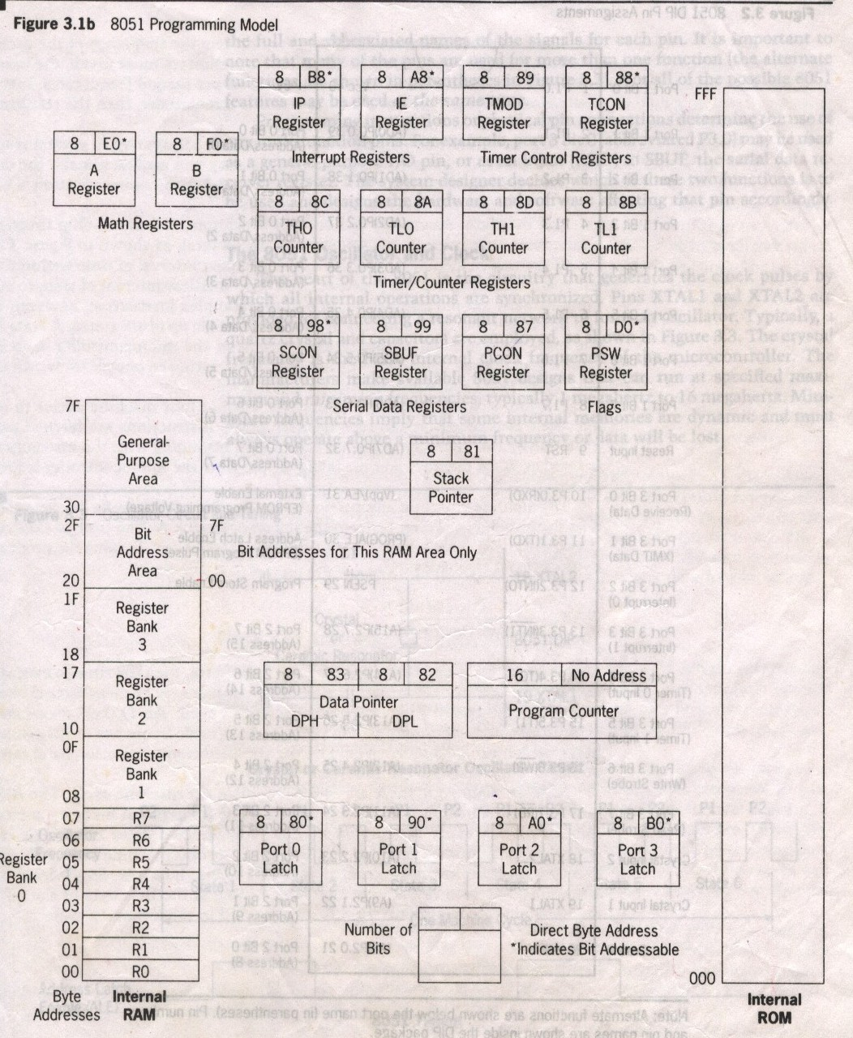
8051 Programming Model

Slide 37
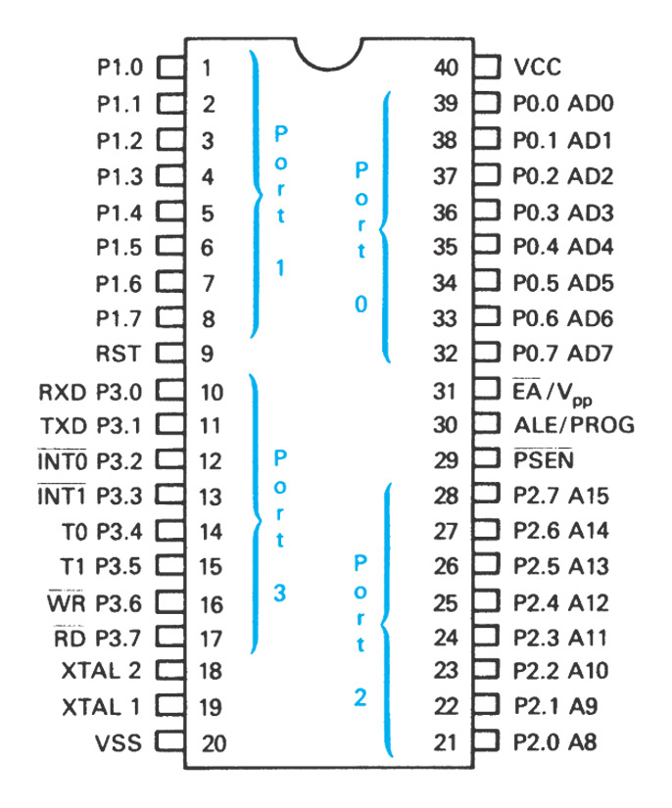

Slide 38
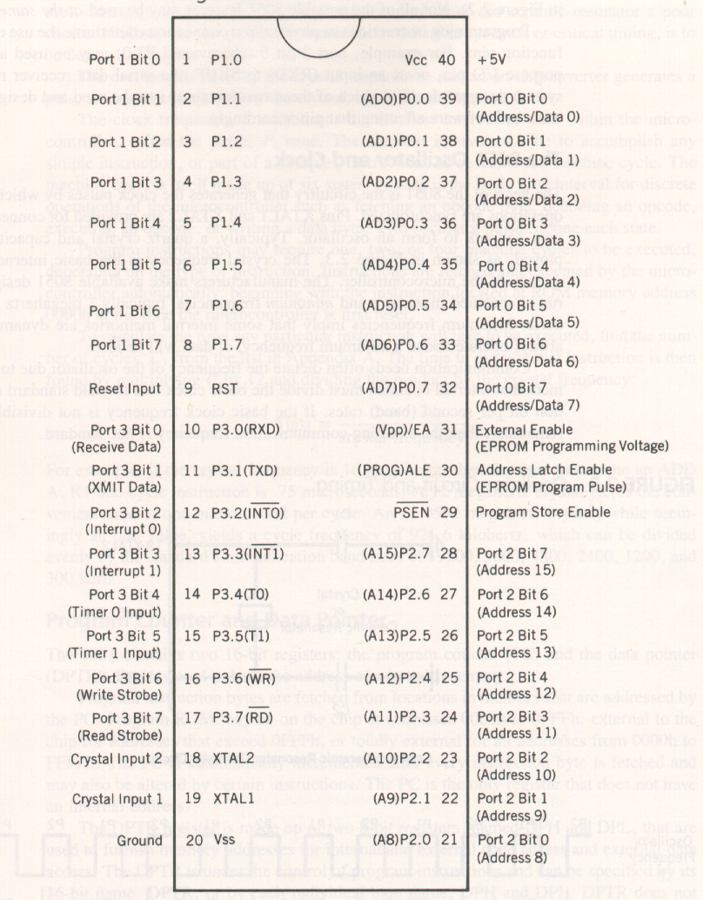

Slide 39
The 8051 Oscillator and Clock
The 8051 generates the clock pulses by which all internal operations are synchronized .
PINs XTAL1 and XTAL2 are provided for connecting a network to form an oscillator
The oscillator formed by the crystal capacitor and an on-chip inverter generates a pulse train at the frequency of the crystal
The clock frequency f establishes a smallest interval of time within the microcontroller called pulse P time
The machine cycle is made up of six states
To calculate the time any particular instruction to be executed number of cycles C
Time execute that instruction is then multiplying C by 12 and dividing the product
T _{inst} =Cx 12d / crystal frequency

Slide 40
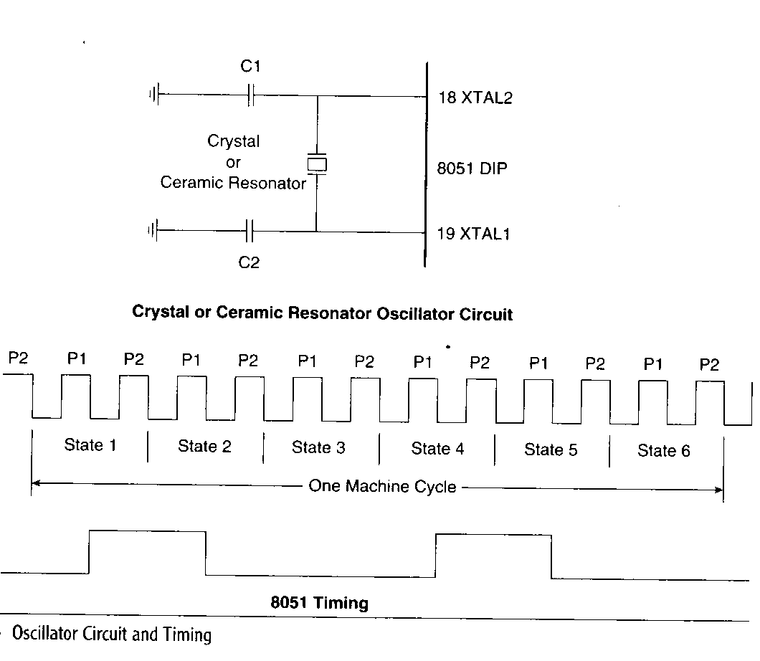

Slide 41
Program Counter and Data Pointer
Program Counter
The 8051 contains two 16-bit registers PC and DPTR
Each is used to hold address byte in memory
Program instruction are fetched from location in memory that are addressed by PC
Program ROM may be on the chip at address 0000h to 0FFFh
The PC is only one register that does not have an internal address .

Slide 42
Data Pointer
The DPTR register is made up of two 8-bit register named DPH and DPL
Which are used to furnish memory addresses for internal and external code accesses and external data access

Slide 43
A and B CPU Registers
The 8051 contains 34 general –purpose, or working register
The register A and B holds results of many instructions such as math and logical operations
The other 32 are arranged as part of internal RAM in four banks B0—B3
The A register is used to data transfer between 8051 and external memory
These register are used of many operations MUL,ADD,SUB, boolean bit manipulations

Slide 44
Flag and the Program status word (PSW)
Flags are one bit register provided to store the results of certain program instruction

Slide 45
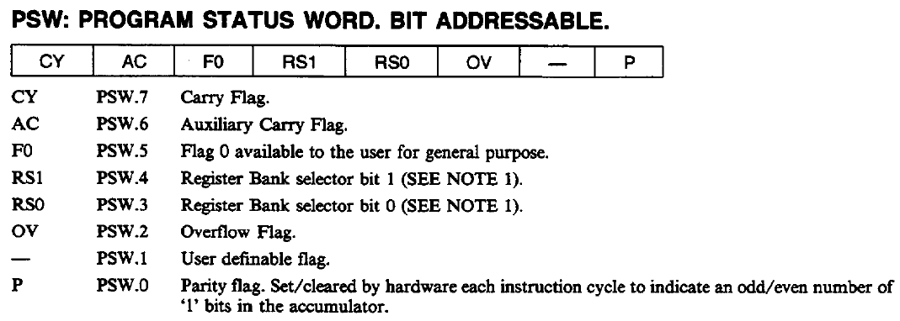
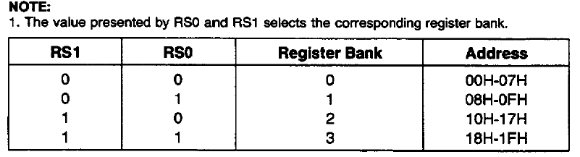

Slide 46
Internal Memory
A functioning computer must have memory for program code bytes commonly in RAM and ROM memory for variable data that can altered as the program runs
The 8051 as internal RAM and ROM memory

Slide 47
Internal RAM
The 8051 has 128 byte internal RAM
Thirty two bytes from address 00h to 1Fh that makes up 32 working registers organized as four four banks of eight register each
Four register bank number as 0 to 3 are made of 8 register RO to R7

Slide 48
Internal RAM
A bit –addressable area of 16 bytes occupies RAM byte addresses 20h to 2Fh forming a total 128 addressable bits specified by its bit address of 00h to 7Fh
A general –purpose RAM area above the bit area from 30h to 7Fh addressable as bytes

Slide 49
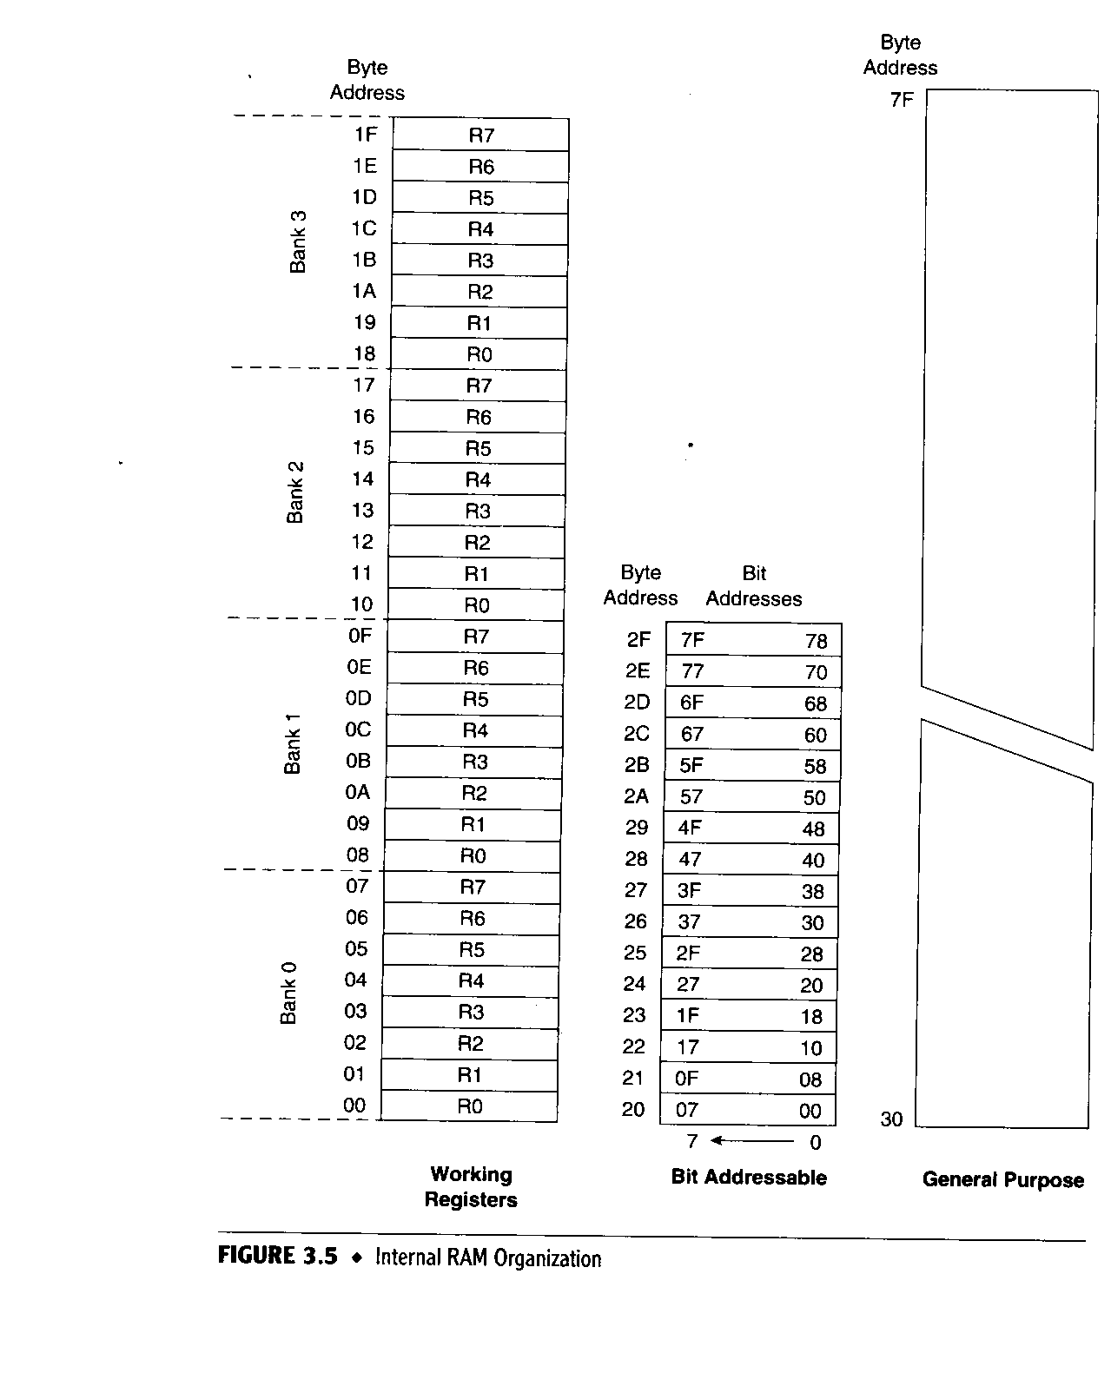

Slide 50
Internal ROM
The 8051 contains a block of internal program code , contained in internal ROM
Occupies code address space 0000h to 0FFFh
The 8051 automatically fetch the code bytes from external program memory

